Slide 1

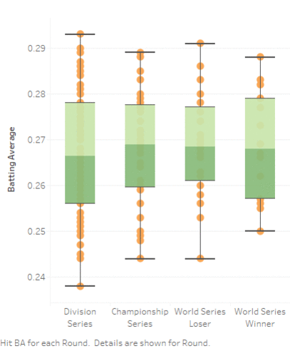
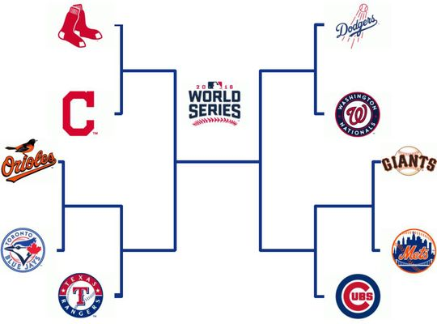

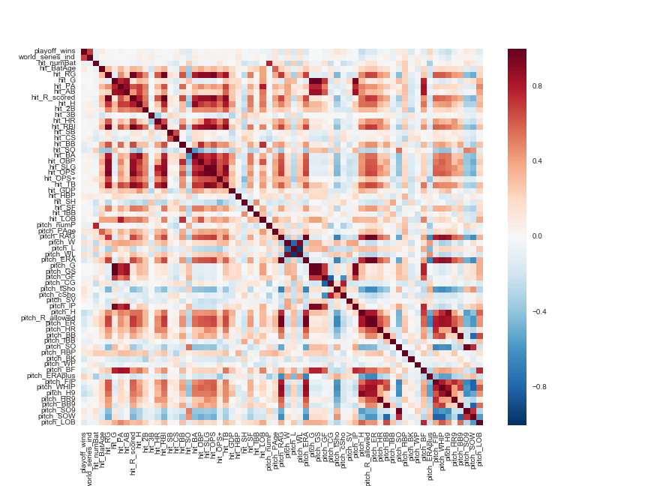


Predicting Major League Baseball Playoff Performance
Goal
Determine which round each team will reach
Data Exploration
Algorithms
Final Model
Model | Features | Accuracy | Precision
KNN | OBP, OPS, SLG, BA, WHIP
Logistic | OBP, OPS, SLG, BA, WHIP
Hit_OBP
Hit_OPS
Hit_SLG
HIT_BA
Pitch_WHIP
?
KNN
K - graph
Logistic
Data
Team statistics from 162 regular season games
Pitching and hitting statistics
Gathered from 1995 – 2016
60+ statistics gathered
Batting average, homeruns, strikeouts, wins, hits, on base percentage, ERA…
Statistics improve as teams advance in playoffs
Feature Selection
Methods | Features
Recursive Feature Elimination (RFE) | OBP, OPS, SLG, BA, WHIP
ExtraTrees Classifier | OBP, OPS, SLG, BA, WHIP
Select K best – Chi² | OBP, OPS, SLG, BA, WHIP
Team Members:
Deepti Aggarwal
Matan Becker
Michael Costner
Rohan Singla
Mehdi ?????
Tools & References
Seaborn
Matplotlib
Py4j
Pyspark
Atexit
Train_test_split
www.baseball-reference.com

